Slide 1
Effect of Banning Subreddits on Community Structure
Vincent Wong

Slide 2
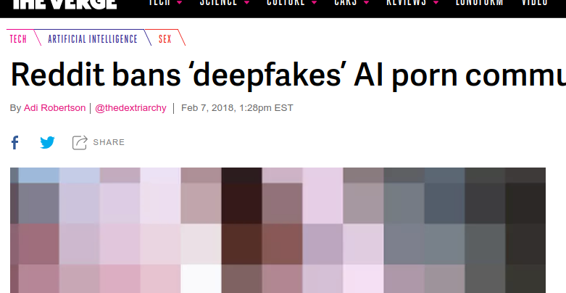
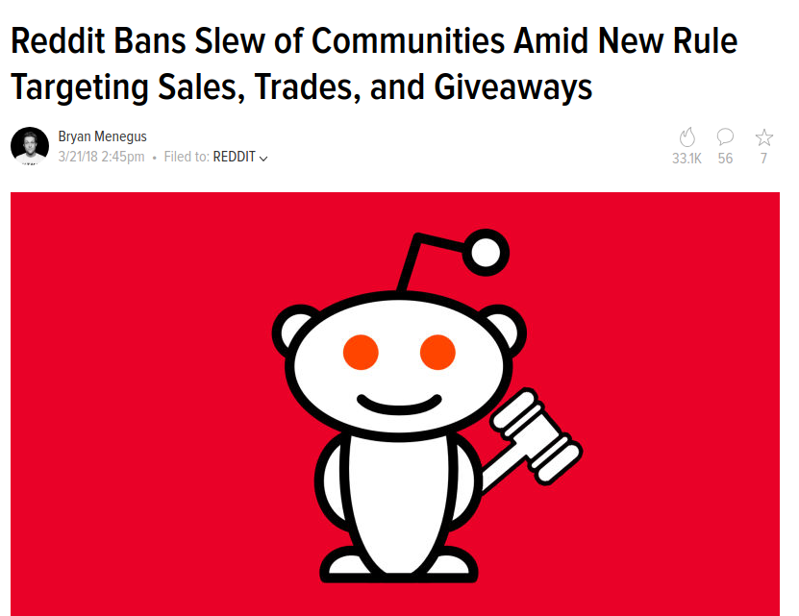
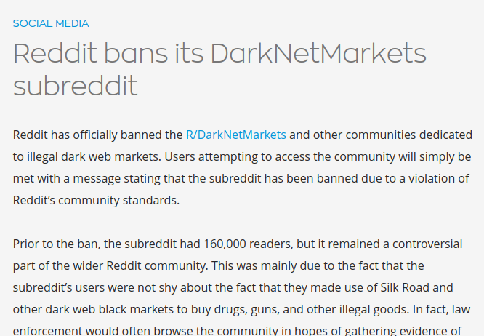
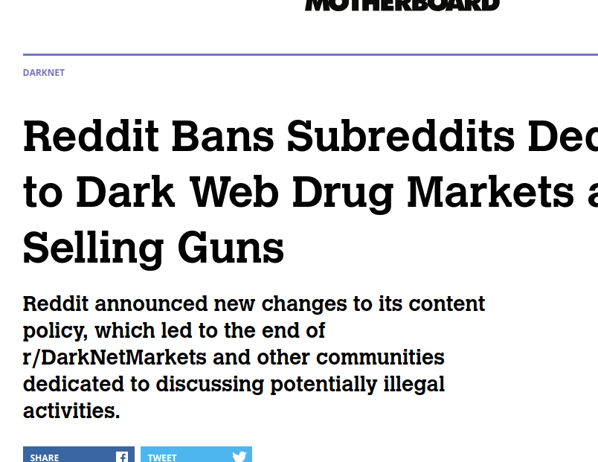
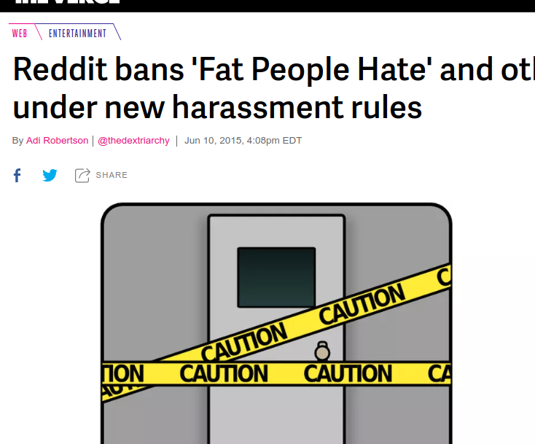
Notes:
Recent attempts for platforms to remove hate content: Reddit, Twitter, Discord, Facebook bans
“The conventional wisdom is that if you ban it, it’ll make it harder to congregate.”

Slide 3
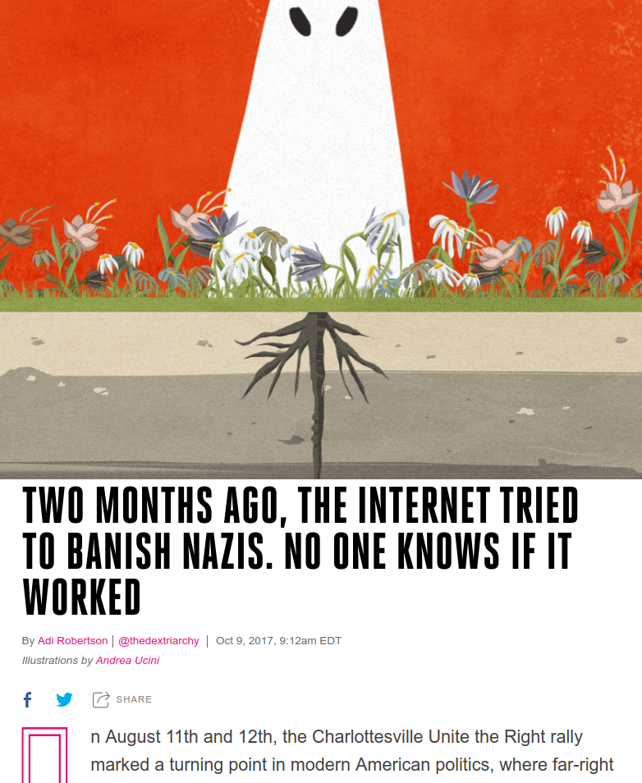
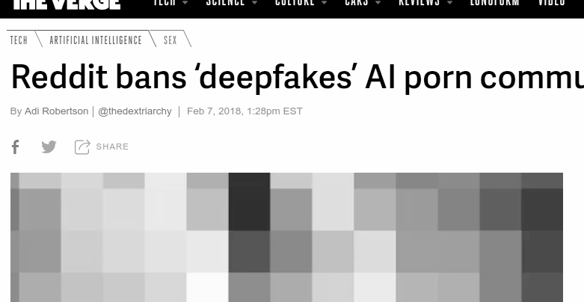
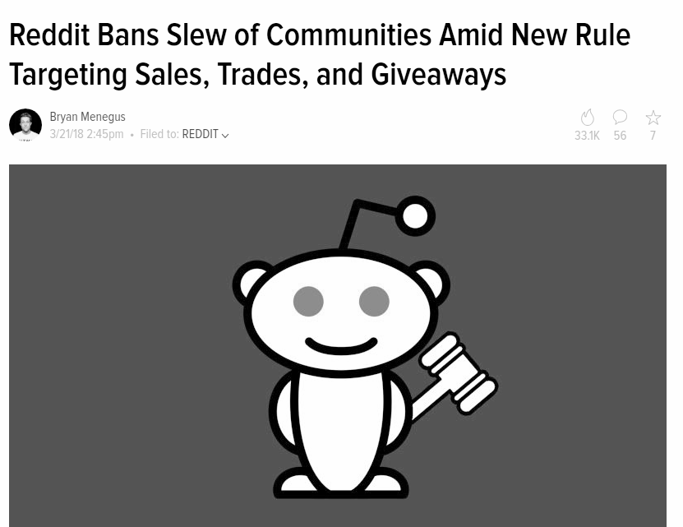
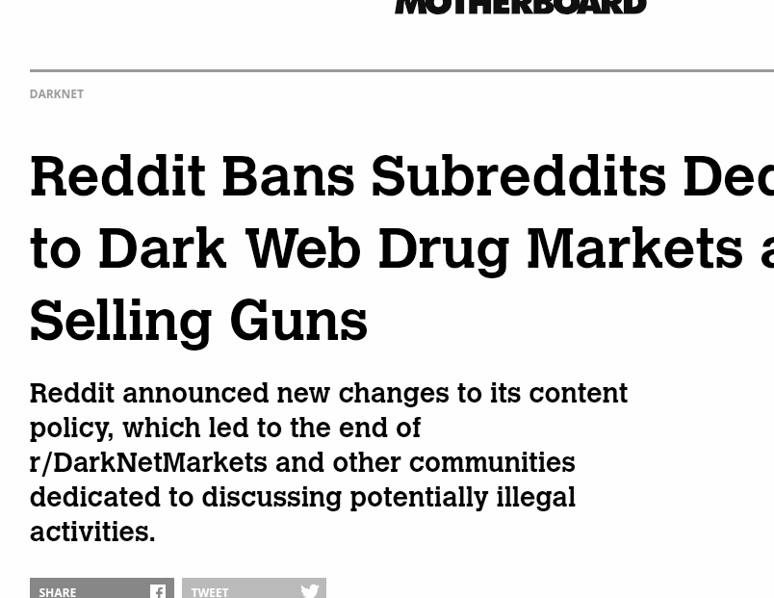
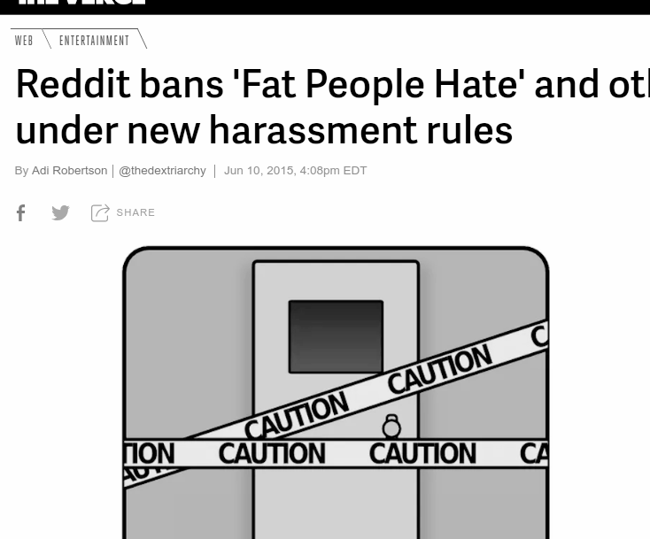
Notes:
Recent attempts for platforms to remove hate content: Reddit, Twitter, Discord, Facebook bans
Then animate question mark

Slide 4
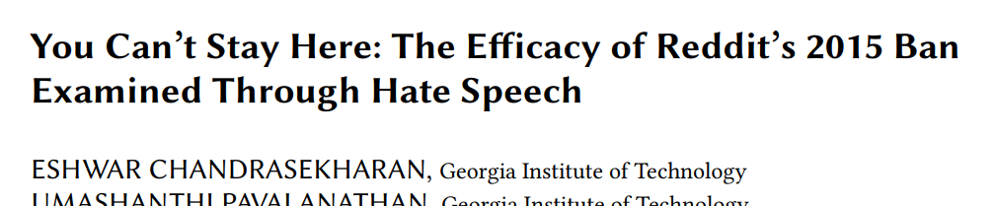
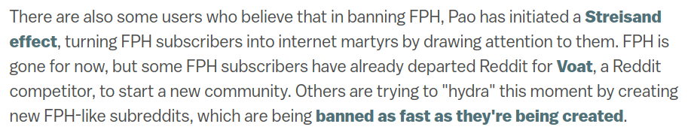
Complicated social phenomena
“Why Reddit’s ban on Fat People Hate is ripping it apart” -- Alex Abad-Santos, Vox

Slide 5
Project: Social networks
!
Let’s see what happened to the community structure

Slide 6
Social networks around the ban
r/altright as a case study
December 2016
January 2017
February 2017
March 2017
banned!
Notes:
Case study: r/altright

Slide 7
The subreddit data
Users
Took users who had posted in r/altright in January 2017, the month before the ban
Posts
Comments by those users from any subreddit in preceding or following two months

Slide 8
Creating networks
user1
w = # of threads
user2
Participated in at least 2 threads together

Slide 9
Networks
1

Slide 10
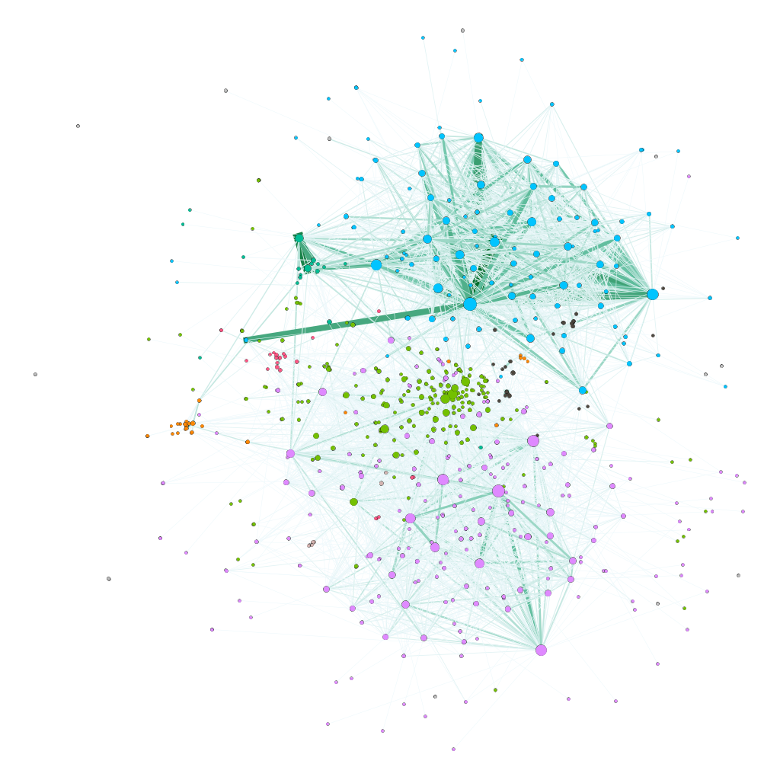
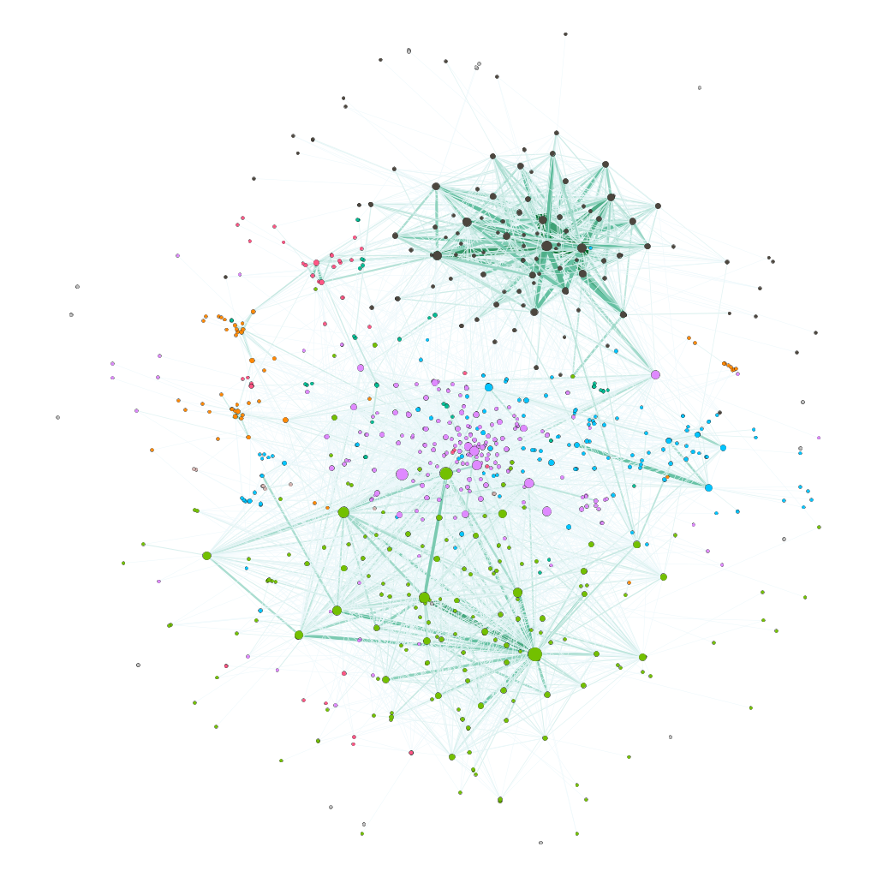
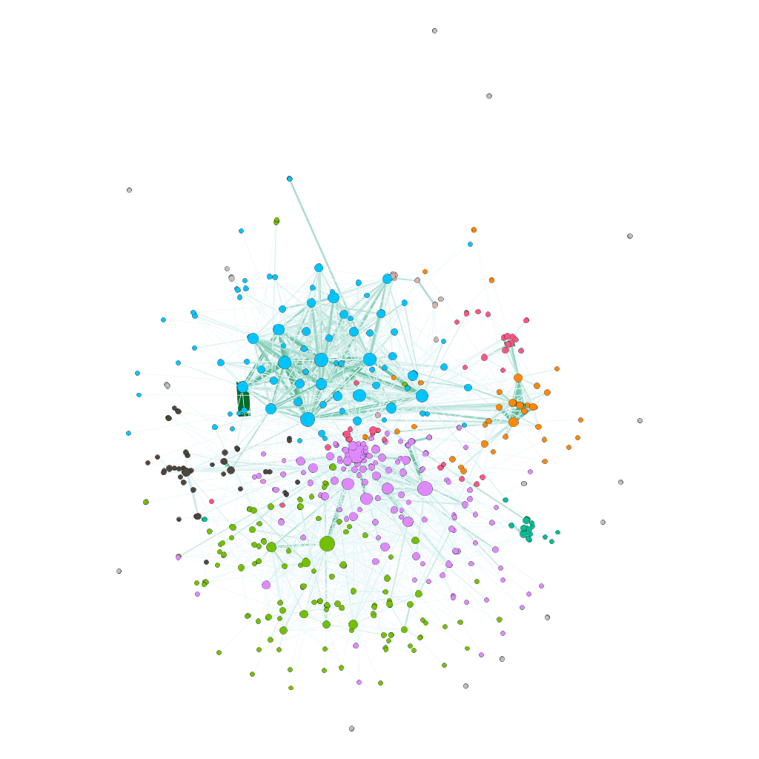
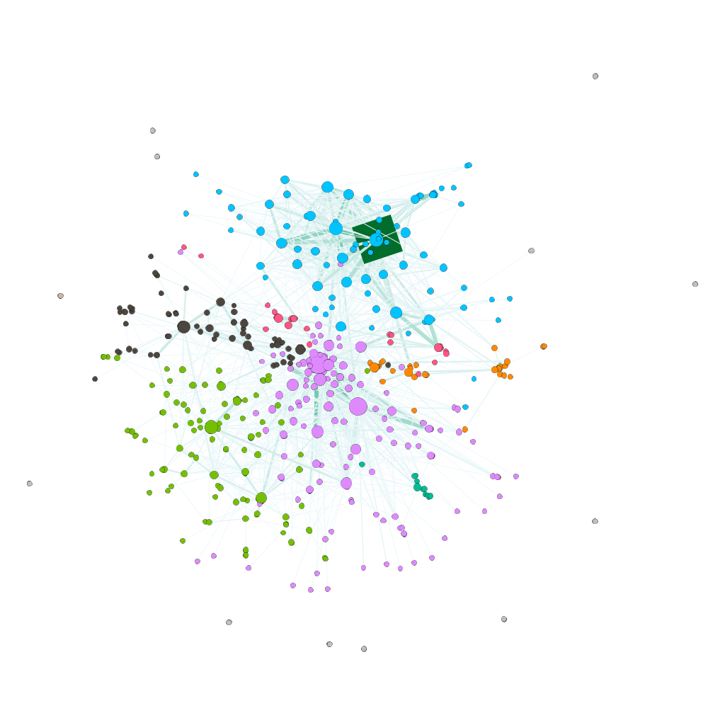
December 2016
January 2017
February 2017
March 2017

Slide 11
(Node colors are modularity class.
Edge colors are weight.)
December 2016
r/DebateAltRight
January 2017
Misc (Popular, nfl, pro wrestling, PCs)
r/MGTOW
r/TheRedPill
r/The_Donald
Popular +
r/The_Donald
729 nodes
836 nodes

Slide 12
(Node colors are modularity class.
Edge colors are weight.)
r/DebateAltRight
February 2017
March 2017
r/CringeAnarchy
Etc popular
r/MGTOW
Popular +
r/The_Donald
Misc (Popular, nfl, pro wrestling, PCs)
570 nodes
497 nodes

Slide 13
Analysis
2

Slide 14
Did anything actually change?
Null model
If the ban changed the community structure, the network would be different than if nodes were removed at random.

Slide 15
Null model - Random deletions
Before ban
?
After ban
Notes:
As a null model, I took the network in January and randomly removed nodes until the number of nodes matched the amount in February.
The basic idea is that if the ban removed a meaningful chunk of the community, any changes in the structure of the network would be different than if I just randomly banned a set of individuals.

Slide 16
Results
 | Reject null? | Value (Mean)
Average degree | No | 6.57 (6.88)
Diameter | No | 8 (9)
Density | No | 0.011 (0.012)
Average clustering coefficient | No | 0.22 (0.26)
Number of cliques | No | 1051 (1168)
Transitivity | Yes | 0.27 (0.24)

Slide 17
Conclusions
Little change to the network
People probably fled the site independently
Future Work
Longer-term analysis
Evaluate across different banned subreddits

Slide 18
Thanks!
Any questions ?
You can find me
at vmwong@iu.edu
standing in front of you

